Slide 1


CSE101 Intro to CS and Programming
Boolean Algebra and Logic Circuits
Lecture 11 (Week 6)
By Mr. Faheem Shaukat
faheem@iqraisb.edu.pk
www.tinyurl.com/IUICLectures

Slide 2
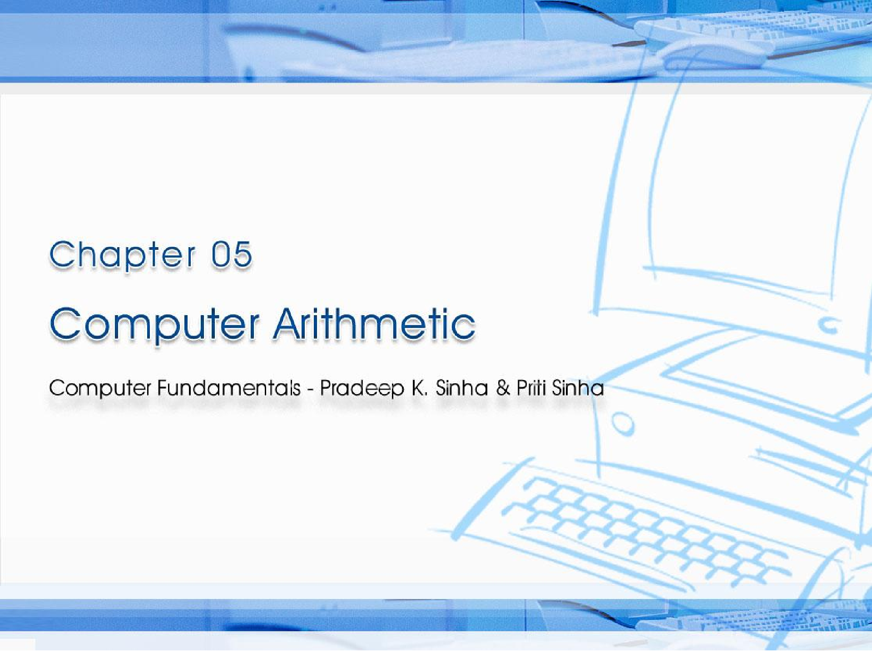
CCoommppuutterer FFununddaammenenttaallss:: PPrradadeeeepp KK.. SSiinhnhaa && PPrriititi SSiinhanha
Ref Page Chapter 5: Computer Arithmetic Slide 1/29

Slide 3

Learning Objectives
Computer Fundamentals: Pradeep K. Sinha & Priti Sinha
In this chapter you will learn about:
Reasons for using binary instead of decimal numbers
Basic arithmetic operations using binary numbers
Addition (+)
Subtraction (-)
Multiplication (*) (Out of Course)
Division (/) (Out of Course)
49
Slide 3/29

Slide 4
Binary over Decimal
Computer Fundamentals: Pradeep K. Sinha & Priti Sinha
Information is handled in a computer by electronic/ electrical components
Electronic components
operate in binary mode (can
only indicate two states – on (1) or off (0)
Binary number system has only two digits (0 and 1), and is suitable for expressing two possible states
In binary system, computer circuits only have to handle two binary digits rather than ten decimal digits causing:
Simpler internal circuit design
Less expensive
More reliable circuits
Arithmetic rules/processes possible numbers
with
binary
49
Slide 4/29

Slide 5

Examples of a Few Devices that work in Binary Mode
Computer Fundamentals: Pradeep K. Sinha & Priti Sinha
Binary State | On (1) | Off (0)
Bulb
Switch
Circuit Pulse
50
Slide 5/29

Slide 6
Binary Arithmetic
Computer Fundamentals: Pradeep K. Sinha & Priti Sinha
Binary arithmetic is simple to learn as binary number system has only two digits – 0 and 1
Following slides show rules and example for the four basic arithmetic operations using binary numbers
50
Slide 6/29

Slide 7
Binary Addition
Computer Fundamentals: Pradeep K. Sinha & Priti Sinha
Rule for binary addition is as follows:
0 + 0 = 0
0 + 1 = 1
1 + 0 = 1
1 + 1 = 0 plus a carry of 1 to next higher column
50
Slide 7/29

Slide 8
Binary Addition (Example 1)
Computer Fundamentals: Pradeep K. Sinha & Priti Sinha
Example
Add binary numbers 10011 and 1001 in both decimal and binary form
Solution
Binary
carry 11
10011
+1001
Decimal
carry 1
19
+9
11100 28
In this example, carry are generated for first and second columns
51
Slide 8/29

Slide 9
Binary Addition (Example 2)
Computer Fundamentals: Pradeep K. Sinha & Priti Sinha
Example
Add binary numbers 100111 and 11011 in both decimal and binary form
Solution
Binary
Decimal
The addition of three 1s
can be broken up into two
steps. First, we add only two 1s giving 10 (1 + 1 =
10). The third 1 is now added to this result to
obtain 11 (a 1 sum with a 1
carry). Hence, 1 + 1 + 1 = 1, plus a carry of 1 to next higher column.
carry | 11111 | carry | 1
 | 100111 |  | 39
 | +11011 |  | +27
66
1000010
51
Slide 9/29

Slide 10
Binary Subtraction
Computer Fundamentals: Pradeep K. Sinha & Priti Sinha
Rule for binary subtraction is as follows:
0 - 0 = 0
0 - 1 = 1 with a borrow from the next column 1 - 0 = 1
1 - 1 = 0
51
Slide 10/29

Slide 11
Binary Subtraction (Example)
Computer Fundamentals: Pradeep K. Sinha & Priti Sinha
Example
Subtract 01110₂ from 10101₂
Solution
12
0202
10101
-01110
00111
Note: Go through explanation given in the book
52

Slide 12
Complement of a Number
Computer Fundamentals: Pradeep K. Sinha & Priti Sinha
Number of digits in the number
C
=
_{B}n
-
1
- N
Complement of the number
Base of the number
The number
52

Slide 13
Complement of a Number (Example 1)
Computer Fundamentals: Pradeep K. Sinha & Priti Sinha
Example
Find the complement of 37₁₀
Solution
Since the number has 2 digits and the value of base is 10,
(Base)^{n} - 1 = 10² - 1 = 99
Now 99 - 37 = 62
Hence, complement of 37₁₀ = 62₁₀
53

Slide 14
Complement of a Number (Example 2)
Computer Fundamentals: Pradeep K. Sinha & Priti Sinha
Example
Find the complement of 6₈
Solution
Since the base is 8,
number has 1 digit and the value of
(Base)^{n} - 1 = 8¹ - 1 = 7₁₀ = 7₈
Now 7₈ - 6₈ = 1₈
Hence, complement of 6₈ = 1₈
53

Slide 15
Complement of a Binary Number
Computer Fundamentals: Pradeep K. Sinha & Priti Sinha
Complement of a binary number can be obtained by transforming all its 0’s to 1’s and all its 1’s to 0’s
Example
Complement of
1 0 1 1 0 1 0 is
0 1 0 0 1 0 1
Note: Verify by conventional complement
53

Slide 16
Complementary Method of Subtraction
Computer Fundamentals: Pradeep K. Sinha & Priti Sinha
Involves following 3 steps:
Step 1: Find the complement of are subtracting (subtrahend)
Step 2: Add this to the number are taking away (minuend)
Step 3: If there is a carry of 1,
the number you
from
which you
add it to obtain
the result; if there is no carry, recomplement the sum and attach a negative sign
Complementary subtraction is an additive approach of subtraction
53

Slide 17
Complementary Subtraction (Example 1)
Computer Fundamentals: Pradeep K. Sinha & Priti Sinha
Example:
Subtract 56₁₀ from 92₁₀ using complementary method.
Solution
Step 1: Complement of 56₁₀
= 10² - 1 - 56 = 99 – 56 = 43₁₀
Step 2: 92 + 43 (complement of 56)
= 135 (note 1 as carry)
The result may be verified using the method of normal subtraction:
Step 3: 35 + 1 (add 1 carry to sum)
Result = 36
92 - 56 = 36
53

Slide 18
Complementary Subtraction (Example 2)
Computer Fundamentals: Pradeep K. Sinha & Priti Sinha
Example
Subtract 35₁₀ from 18₁₀ using complementary method.
Solution
Step 1: Complement of 35₁₀
= 10² - 1 - 35
Step 3: Since there is no carry,
re-complement the sum and attach a negative sign to
obtain the result.
= 99 - 35
= 64₁₀
Step 2:
18
+ 64 (complement
Result
= -(99 - 82)
= -17
of 35)
The result may be verified using normal subtraction:
82
18 - 35 = -17
53

Slide 19
Binary Subtraction Using Complementary Method (Example 1)
Computer Fundamentals: Pradeep K. Sinha & Priti Sinha
Example
Subtract 0111000₂ (56₁₀) from 1011100₂ (92₁₀) using complementary method.
Solution
1011100
+1000111 (complement of 0111000)
10100011
1 (add the carry of 1)
0100100
Result = 0100100₂ = 36₁₀
53

Slide 20
Binary Subtraction Using Complementary Method (Example 2)
Computer Fundamentals: Pradeep K. Sinha & Priti Sinha
Example
Subtract 100011₂ (35₁₀) from 010010₂ (18₁₀) using complementary method.
Solution
010010
+011100 (complement of 100011)
101110
Since there is no carry, we have to complement the sum and attach a negative sign to it. Hence,
Result = -010001₂ (complement of 101110₂)
= -17₁₀
54

Slide 21
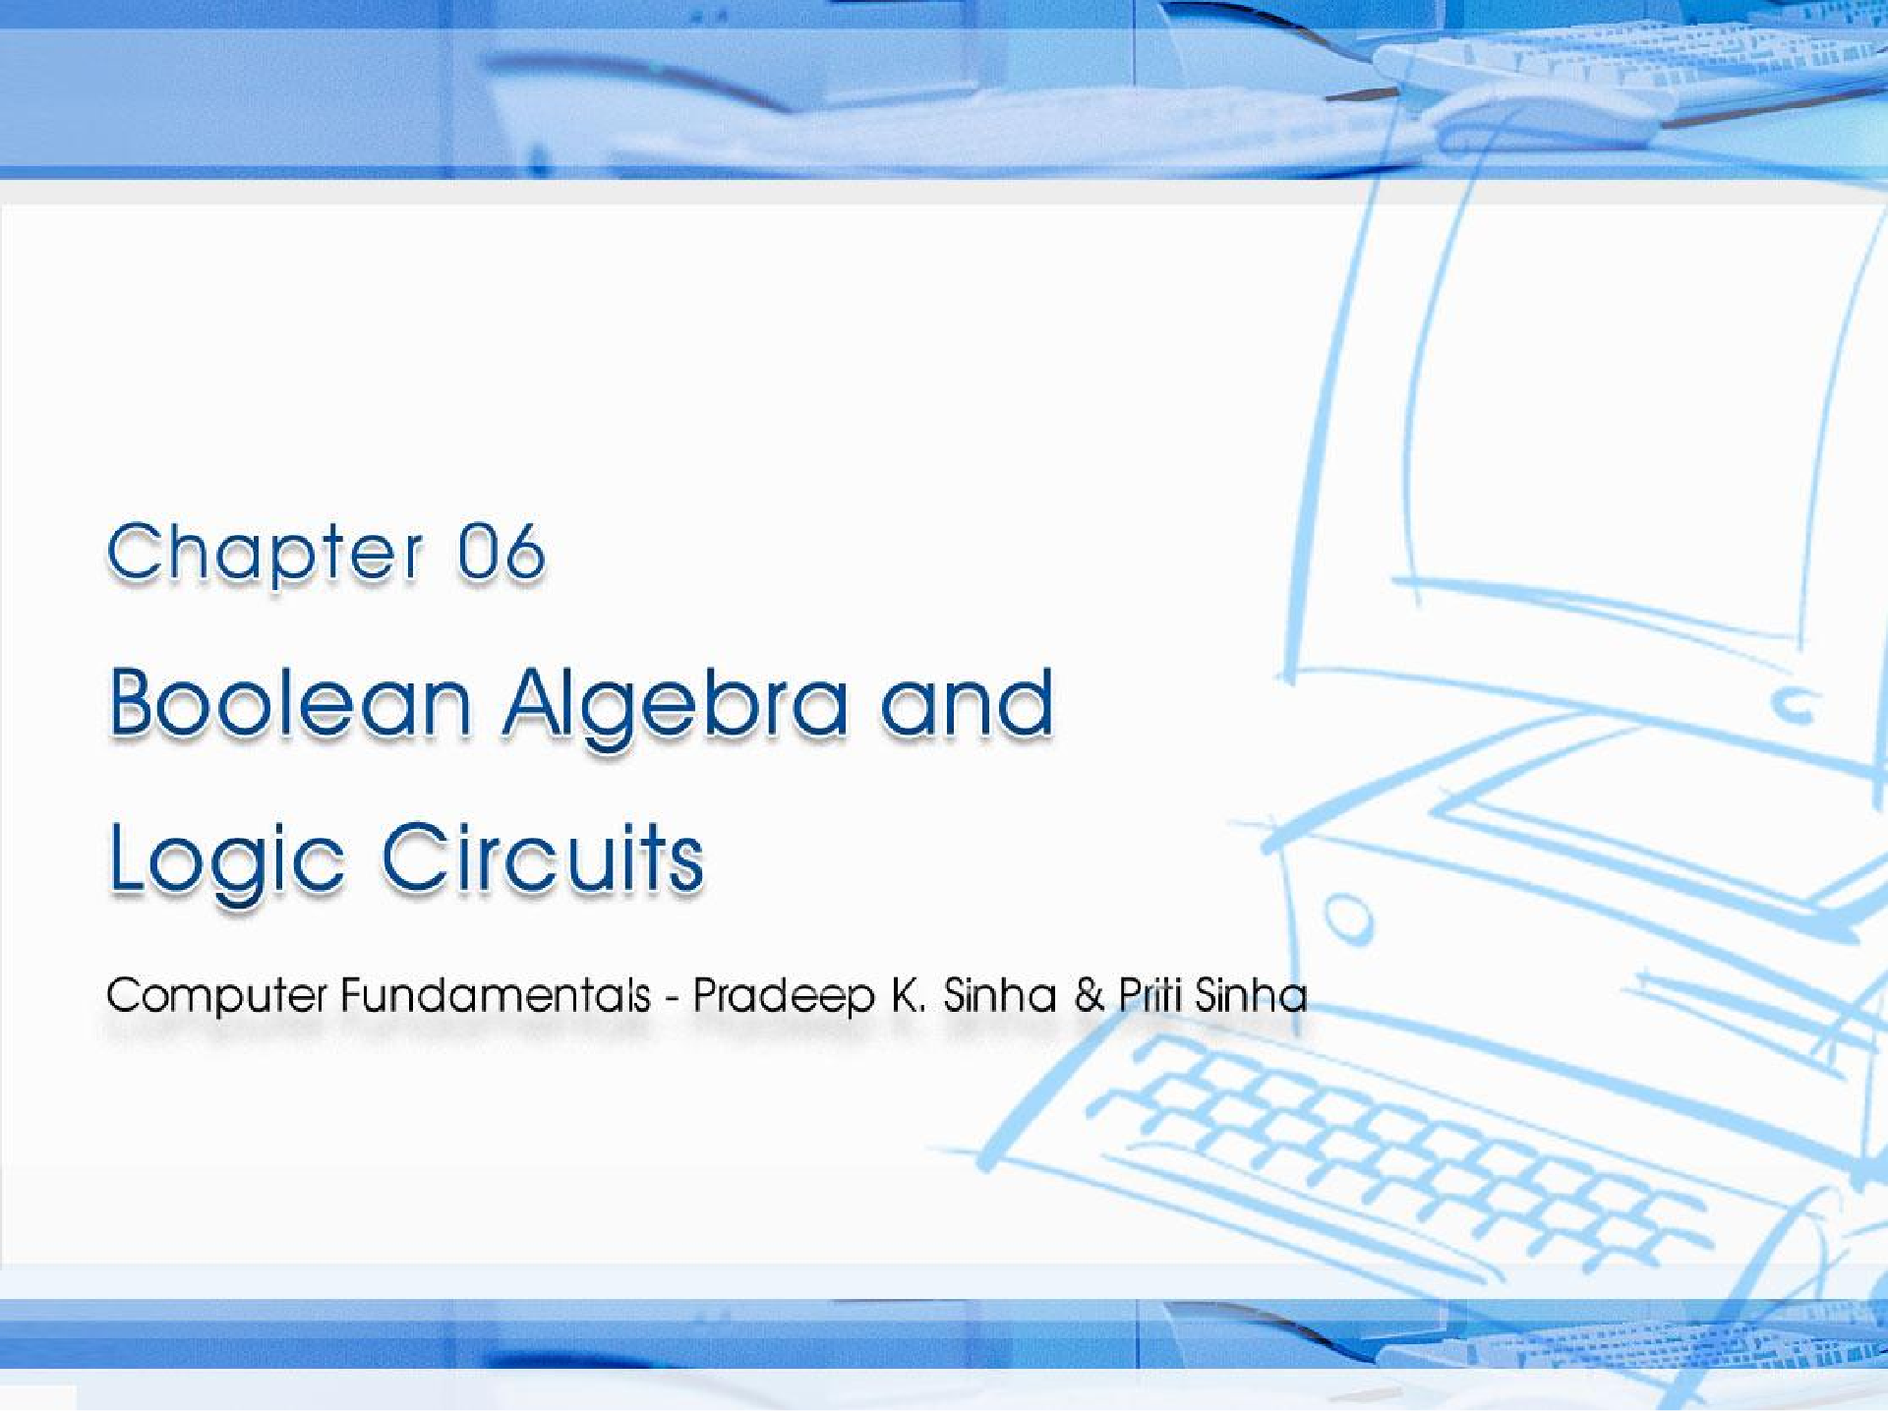
CCoommppuutterer FFununddaammenenttaallss:: PPrradadeeepep KK.. SSiinhanha && PPrriititi SSiinhanha
Ref. Page Chapter 6: Boolean Algebra and Logic Circuits Slide 1/78

Slide 22
Learning Objectives
Computer Fundamentals: Pradeep K. Sinha & Priti Sinha
In this chapter you will learn about:
Fundamental concepts and basic laws of Boolean algebra
Boolean function and minimization
Logic gates
Logic circuits and Boolean expressions
60
Slide 22/78

Slide 23
Fundamental Concepts of Boolean Algebra
Computer Fundamentals: Pradeep K. Sinha & Priti Sinha
Use of Binary Digit
Boolean equations can have either of two possible values, 0 and 1
Logical Addition
Symbol ‘+’, also known as ‘OR’ operator, used for logical addition. Follows law of binary addition
Logical Multiplication
Symbol ‘.’, also known as ‘AND’ operator, used for logical multiplication. Follows law of binary multiplication
Complementation
Symbol ‘-’, also known as ‘NOT’ operator, used for complementation. Follows law of binary compliment
61
Slide 23/78

Slide 24
Operator Precedence
Computer Fundamentals: Pradeep K. Sinha & Priti Sinha
Higher the operator’s precedence level, earlier it is evaluated
Expression is scanned from left to right
First, expressions enclosed within parentheses are evaluated
Then, all complement (NOT) operations are performed
Then, all ‘⋅’ (AND) operations are performed
Finally, all ‘+’ (OR) operations are performed
(Continued on next slide)
62
Slide 24/78

Slide 25
Computer Fundamentals: Pradeep K. Sinha & Priti Sinha
Operator Precedence
(Continued from previous slide..)
X + Y ⋅ Z
₁st
₂nd
₃rd
62
Slide 25/78

Slide 26
Boolean Functions
Computer Fundamentals: Pradeep K. Sinha & Priti Sinha
A Boolean function is an expression formed with:
Binary variables
Operators (OR, AND, and NOT)
Parentheses, and equal sign
The value of a Boolean function can be either 0 or 1
A Boolean function may be represented as:
An algebraic expression,
A truth table
Logical Circuit
67

Slide 27
Representation as an Algebraic Expression
Computer Fundamentals: Pradeep K. Sinha & Priti Sinha
W = X + Y ·Z
Variable W is a function of X, Y, and Z, can also be written as W = f (X, Y, Z)
The RHS of the equation is called an expression
The symbols X, Y, Z are the literals of the function
For a given Boolean function, there may be more than one algebraic expressions
67

Slide 28
Representation as a Truth Table
Computer Fundamentals: Pradeep K. Sinha & Priti Sinha
X | Y | Z | W
0 | 0 | 0 | 0
0 | 0 | 1 | 1
0 | 1 | 0 | 0
0 | 1 | 1 | 0
1 | 0 | 0 | 1
1 | 0 | 1 | 1
1 | 1 | 0 | 1
1 | 1 | 1 | 1
(Continued on next slide)
67

Slide 29
Representation as a Truth Table
Computer Fundamentals: Pradeep K. Sinha & Priti Sinha
(Continued from previous slide..)
The number of rows in the table is equal to 2^{n}, where
n is the number of literals in the function
The combinations of 0s and 1s for rows of this table are obtained from the binary numbers by counting from 0 to 2^{n} - 1
67

Slide 30
Logic Gates
Computer Fundamentals: Pradeep K. Sinha & Priti Sinha
Logic gates are electronic circuits that operate on one or more input signals to produce standard output signal
Are the building blocks of all the circuits in a computer
Some of the most basic and useful logic gates are AND, OR, NOT, NAND and NOR gates
77

Slide 31
AND Gate
Computer Fundamentals: Pradeep K. Sinha & Priti Sinha
Physical operation
realization
of logical
multiplication
(AND)
Generates an output signal signals are also 1
of 1 only if all input
77

Slide 32
AND Gate (Block Diagram Symbol and Truth Table)
Computer Fundamentals: Pradeep K. Sinha & Priti Sinha
A B
C = A ⋅ B
Inputs |  | Output
A | B | C = A ⋅ B
0 | 0 | 0
0 | 1 | 0
1 | 0 | 0
1 | 1 | 1
77

Slide 33
OR Gate
Computer Fundamentals: Pradeep K. Sinha & Priti Sinha
Physical realization of logical addition (OR) operation
Generates an output signal of 1 if at least one of the input signals is also 1
77

Slide 34
OR Gate (Block Diagram Symbol and Truth Table)
Computer Fundamentals: Pradeep K. Sinha & Priti Sinha
A
B
C = A + B
Inputs |  | Output
A | B | C = A + B
0 | 0 | 0
0 | 1 | 1
1 | 0 | 1
1 | 1 | 1
78

Slide 35
NOT Gate
Computer Fundamentals: Pradeep K. Sinha & Priti Sinha
Physical realization of complementation operation
Generates an output signal, which is the reverse of the input signal
78

Slide 36
NOT Gate (Block Diagram Symbol and Truth Table)
Computer Fundamentals: Pradeep K. Sinha & Priti Sinha
A
A
Input | Output
A | A
0 | 1
1 | 0
79

Slide 37
NAND Gate
Computer Fundamentals: Pradeep K. Sinha & Priti Sinha
Complemented AND gate
Generates an output signal of:
1 if any one of the inputs is a 0
0 when all the inputs are 1
79

Slide 38
NAND Gate (Block Diagram Symbol and Truth Table)
Computer Fundamentals: Pradeep K. Sinha & Priti Sinha
A
B
C= A ↑B= A ⋅B= A +B
Inputs |  | Output
A | B | C = A +B
0 | 0 | 1
0 | 1 | 1
1 | 0 | 1
1 | 1 | 0
79

Slide 39
NOR Gate
Computer Fundamentals: Pradeep K. Sinha & Priti Sinha
Complemented OR gate
Generates an output signal of:
1 only when all inputs are 0
0 if any one of inputs is a 1
79

Slide 40
NOR Gate (Block Diagram Symbol and Truth Table)
Computer Fundamentals: Pradeep K. Sinha & Priti Sinha
A
B
C= A ↓B= A +B= A ⋅ B
Inputs |  | Output
A | B | C = A ⋅ B
0 | 0 | 1
0 | 1 | 0
1 | 0 | 0
1 | 1 | 0
80

Slide 41
Logic Circuits
Computer Fundamentals: Pradeep K. Sinha & Priti Sinha
When logic gates are interconnected to form a gating / logic network, it is known as a combinational logic circuit
The Boolean algebra expression for a given logic circuit can be derived by systematically progressing from input to output on the gates
The three logic gates (AND, OR, and NOT) are logically complete because any Boolean expression can be realized as a logic circuit using only these three gates
80

Slide 42
Finding Boolean Expression
of a Logic Circuit (Example 1)
Computer Fundamentals: Pradeep K. Sinha & Priti Sinha
A
A
NOT
D= A ⋅(B + C)
B C
B + C
AND
OR
80

Slide 43
Finding Boolean Expression
of a Logic Circuit (Example 2)
Computer Fundamentals: Pradeep K. Sinha & Priti Sinha
OR
A B
A + B
C=(A +B)⋅(A⋅ B)
A ⋅B
A⋅B
AND
AND
NOT
81

Slide 44
Constructing a Logic Circuit from a Boolean Expression (Example 1)
Computer Fundamentals: Pradeep K. Sinha & Priti Sinha
Boolean Expression =
A ⋅B +C
AND
A B
A ⋅B
A ⋅B +C
C
OR
83

